Slide 1
General SHAC Meeting
Wednesday, September 6, 2023

Slide 2
Welcome & Mindful Moment
Allison Thummel
SHAC Chair

Slide 3
Introductions
SHAC Subcommittee Leaders
Whole Child Health, Nutrition, Advocacy, Health & PE, Health & Safety, Campus Wellness

Slide 4
SHAC Overview
Allison Thummel
FBISD SHAC Chair

Slide 5
School Health Advisory Council

Slide 6
SHAC Vision, Mission
VISION: The FBISD School Health Advisory Council (SHAC) was established by the Board of Trustees to assist the District in meeting its strategic objectives to provide healthy school environments for students, staff and community members and to teach and promote wellness through healthy lifestyles. The SHAC acts in an advisory capacity to the Superintendent and Board of Trustees.
MISSION: The FBISD SHAC shall use the Whole School, Whole Child, Whole Community (WSCC) model, the Board of Trustee Goals and the FBISD Profile of a Graduate attributes to support the FBISD community for the purpose(s) of effectively implementing the District Wellness Policy-FFA (Local), while promoting evidence-based wellness resources that encourage and foster lifelong wellness of staff, students and the community.

Slide 7
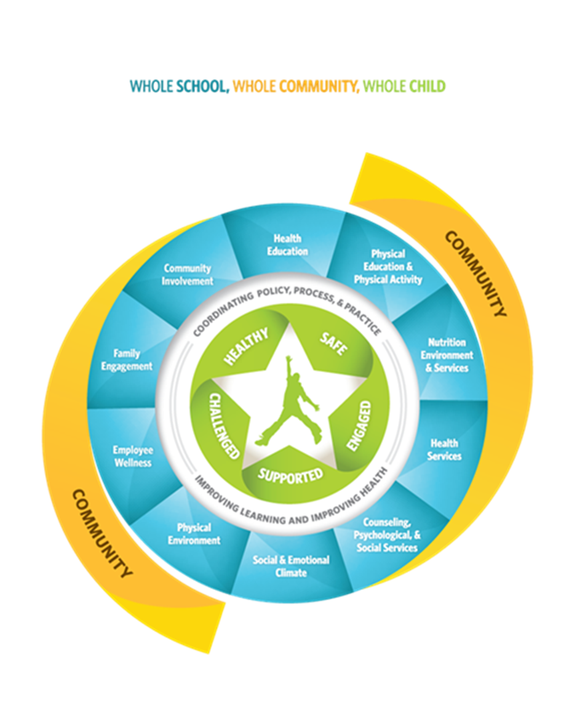
WSCC Model
Allison Thummel
SHAC Chair

Slide 8
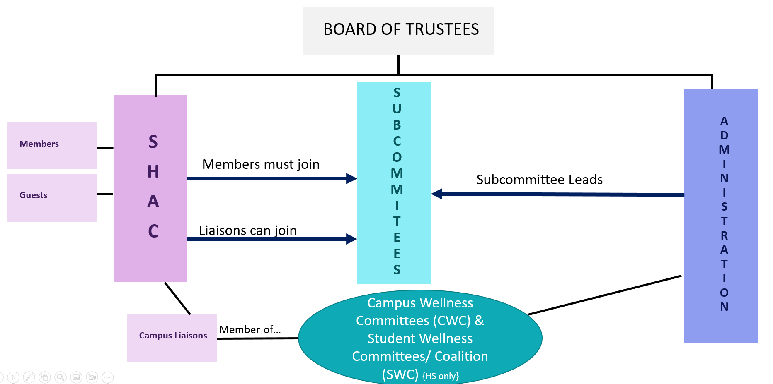
FBISD SHAC Org Chart

Slide 9
SHAC Member Responsibilities
Regularly attend the SHAC general meetings.
Actively participate in at least one subcommittee each year.
Participate in voting.
Review materials to prepare for the SHAC meetings and subcommittee meetings.
Participate as needed to help fulfill the SHAC stated responsibilities in Article II of the SHAC Bylaws.

Slide 10
2022-24 SHAC Subcommittee Leaders
Advocacy
Chassidy Olainu-Alade (district) Rocaille Roberts & Jenna Ross (parent)
Campus Safety
Nicholas Petito
Campus Wellness Committees
LaDonna Green Allison Thummel (parent)
Nutrition
Sierra Bell
Physical Activity &
Physical Education
Kim Taylor
Whole Child Health
Lori Sartain

Slide 11
Where SHAC Has Been(2022-23)
Recommend expansion of Action Based Learning Labs
Create and implement recognition programs for Campus Wellness Champions
Increase opportunities for high school students to engage in physical activities
Create a process to communicate and promote all WCH programs and resources in the District
Continue to provide mental health supports for students and staff
Develop a process for SHAC to provide input on any policies related to WSCC

Slide 12
Where SHAC Has Been(2022-23)
Campus Wellness Committees – 100% Participation
Student Wellness Coalitions – 100% Participation, Inaugural Think Tank
Adoption of Prevention Support Materials through Proclamation 2022
Support & Promote the Whole Child Health Initiative (Events & Webinars)
SHAC Inaugural Legislative Priorities
Facts From the SHAC
Notes:
Presenter: Allison
Time: 1 minute
Say: We are so proud of our accomplishments…and here is a summary of what the SHAC has accomplished:

Slide 13
SHAC Legislative Priorities
The FBISD SHAC Supports:
The Texas’ Whole School, Whole Community, Whole Child (WSCC) Model for coordinated school health and supports measures that strengthen Local Education Agencies’ (LEA) implementation of policies and practices consistent with this approach.
Measures that enhance local communities’ ability to inform local decision-making of LEAs through the formation or support of formal advisory groups such as SHACs.
Measures encouraging physical fitness and Action Based Learning, including effective use of fitness assessments.
Funding for a multi-tiered system of mental and behavioral health support that fosters safe and healthy school environments for students, educators and staff.
Measures to ensure that all children receive access to healthy school meals, including breakfast and lunch to reduce food insecurity and hunger.
Improved, continual, reliable funding for access to evidence-based mental health services.
Notes:
Presenter: Allison
Time: 3 minute
Say: Another focus of ours was designing 6 Legislative Priorities, since our Texas Legislature is now in full swing. These are the measures that we support, and encourage individuals to advocate for. Reaching out to our representatives was encouraged to all the SHAC members and guests. Being involved in the legislative process is important.

Slide 14
CWC, SWC, DSWC
CWC: Campus Wellness Committee- a group on campus, staff-driven, typically led by AP, RN or Counselor. SHAC wants a parent liaison on CWCs.
SWC: Student Wellness Committee-a group on high school campuses, student-driven and staff-facilitated. A parent liaison can participate in SWCs.
DSWC: District Student Wellness Coalition-a group of high school students, typically representing their school SWC. District will provide staff advisors and coordinate regular meetings.

Slide 15
Where SHAC Is Going (2023-24)
In the 2023-2024 the Fort Bend Independent School District School Health Advisory Council (SHAC) will:
1. Develop a process for SHAC to provide input on Board adopted Legislative Priorities
2. Increase support and awareness of Student Wellness Committees & recognition of their sponsors
3. Ensure Campus Improvement Plans include wellness strategies created by their Campus Wellness Committee
4. Develop a process for the district to provide families with gun safety and storage information
5. Recommend expansion of Action Based Learning Labs and including movement in classrooms (all levels)
6. Expand District level mental health supports available to ALL students
Notes:
Presenter: Allison
Time: 1 minute
Say: We are so proud of our accomplishments…and here is a summary of what the SHAC has accomplished:

Slide 16
Subcommittee Goals
PA& PE:
1 Support ABL Labs & Expansion. 2 Provide opportunities for teachers to learn how to include ABL and movement activities into their classrooms. 3 Create opportunities for district wide sporting events and/or physical activity for elementary students after school.
Campus Safety:
1 Gun safety: To provide the district’s stakeholders with important common sense gun safety information in an effort to educate our community so they are equipped to have conversations that promote responsible, safe gun ownership. 2 Drug awareness: To build relationships with local partners to help us educate our community as we increase drug awareness in order to reduce and prevent substance abuse.
WCH:
1 Increase awareness about social-emotional learning and how it can be integrated into academics at the Tier I level. 2 Create a culture of awareness towards mental health within the district and the community. 3 Increase the number of Mental Health Counselors employed by the district, to one per High School feeder pattern. 4 Nurse Appreciation: To say thank you and express gratitude for the tireless efforts and hard work nurses give daily to students, staff, coworkers and visitors on campus during nurse appreciation week each year in May.
Advocacy:
1 Engage with and inform the policy development process at FBISD following the passage of laws from the 87th Legislative Session/2021 special sessions, the 88th Legislative Session or federal laws that impact school wellness
2 Inform and learn from elected/appointed leaders and/or staff at the state level in the Texas Legislature, Texas Board of Education, Texas Education Agency and local level
3 Inform and learn from Advocacy and/or Civic Engagement organizations
4 Engage the SEL/Student Wellness Coalitions, Student VOICES Advisory Network, the Communications Department (via Civic & Community Engagement), and Fort Bend Student Leadership 101/102 for voter registration, advocacy and other civic engagement opportunities
Notes:
Presenter: Allison
Time: 1 minute
Say: We are so proud of our accomplishments…and here is a summary of what the SHAC has accomplished:

Slide 17
2023-2024 SHAC Dates
October 18
December 6
February 28
April 10
May 15
12-2pm @ the FB Administration Bldg. Bring your lunch, if you’d like!

Slide 18
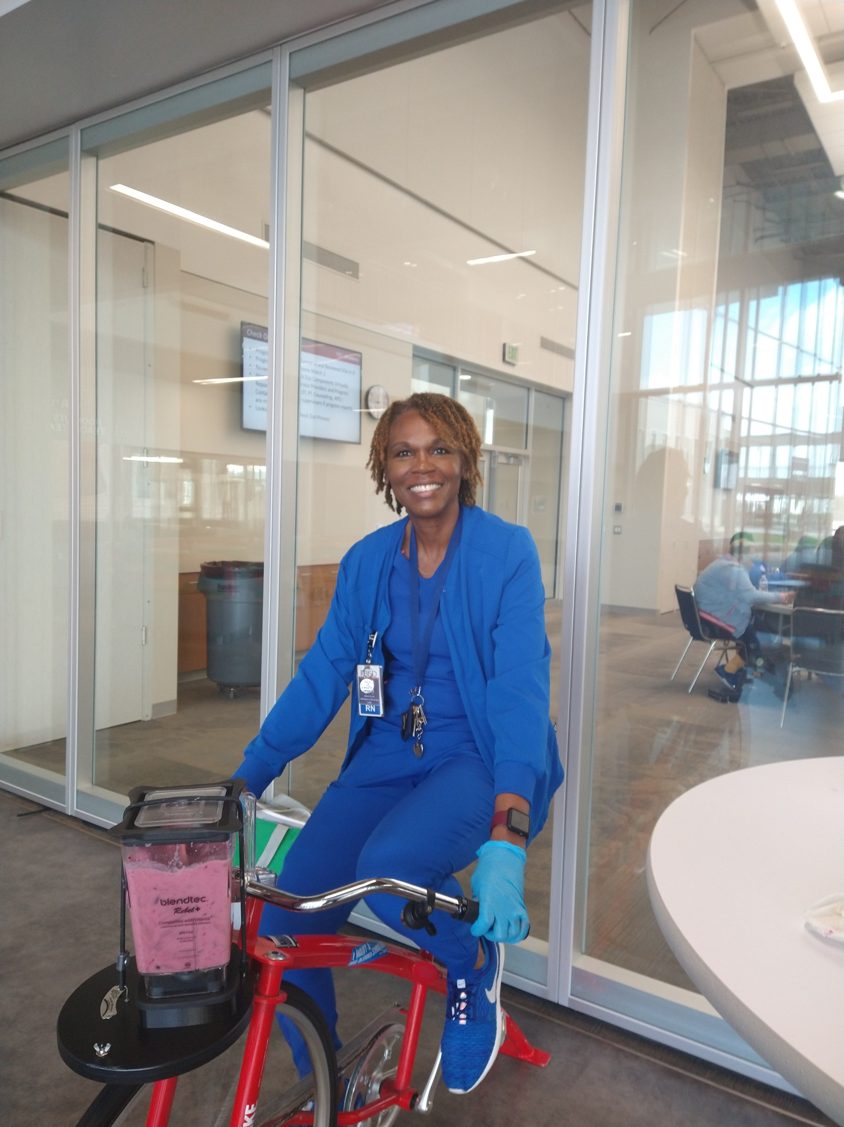
SHAC Resources
Prevention Support (Child Abuse, Family Violence, Dating Violence & Sex Trafficking)
Smoothie Bike
Speakers, Programs, Planning resources
Virtual Health School (VHS)

Slide 19
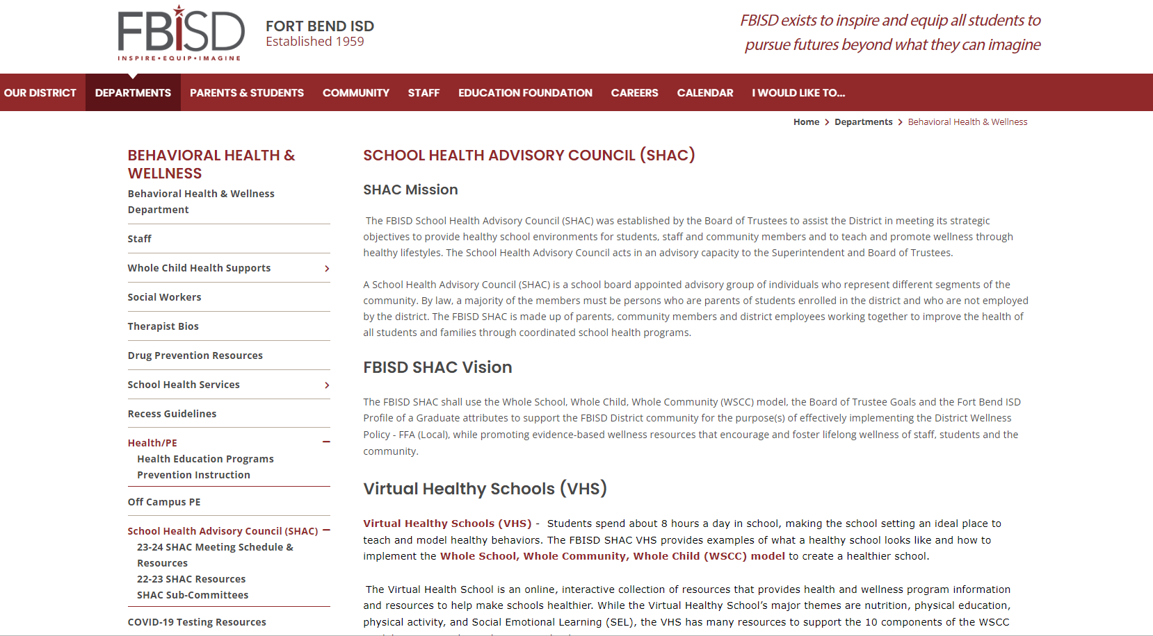
How to Access the VHS

Slide 20
SHAC- Whole Child Health
Lori Sartain
FBISD Assistant Director of Health & Wellness

Slide 21
Focus
Expand Health Services
Increase Awareness of Health Services and Resources
Decrease Stigma Around Mental Health
Notes:
Whole Child Health values both physical and mental health and views them as interconnected. Students need different types of support on our Multi-Tier System of Supports (MTSS) at different times in their academic to equip and inspire them to pursue futures beyond what they can imagine. A visit to a school counselor or school nurse in Tier One is enough for most students. Other students need more intensive support in Tier Two and Tier Three to get back in school and functioning at their highest level. The goal of these diverse services is to ensure accessible and exceptional support of Whole Child Health.

Slide 22
Removing Barriers
Access
Stigma
Financial
Campus-based
During the school day
Awareness of services
Normalizing
It’s ok to ask for help.
Labeling
Grants
Insurance
Medicaid
FBISD Mental Health Counselors
Notes:
First, the success of Whole Child Health will be measured by increase in access to all services. This includes VOCA grant, all campus-based mental health services, and vaccinations. We have also started the journey and measuring individual student outcomes and the performance of those receiving health services. This includes an increase in attendance, a decrease in discipline referrals and we’re looking at resiliency through research-based resiliency scale. Finally, we are looking to decrease COVID-19 cases and even flu cases as we vaccinate students and staff and continue our safety mitigations of contact tracing, social distancing, and other mitigation measures.

Slide 23
Whole Child Health Strategies
Parent Education
Business and Community Partnerships
Counselor Support
Strategy
Expand Services
Student Voice and Promotion
Notes:
The key strategies to accomplish our goals of increasing awareness and decreasing stigma include parent education, counselor support, student voice and promotion, continuing to expand services and to continue to develop business and community partnerships to both serve students and to help us promote our existing supports and resources. Obviously, to increase awareness and decrease stigma, education is the foundation. We are planning out monthly sessions for stakeholders which include health and wellness topics as well as showcasing our services. We will also partner with campuses to do their own events for their community. School counselors play a critical role in linking students and families to resources and they need training on the existing services and support in helping make the services visible on their campus. We are meeting with Student Voices to solicit their feedback on the best ways and platforms to reach them. They are really our primary audience so we need their help in getting the word out! We will continue to expand services and our currently exploring student vaccination and telehealth opportunities as well staffing the community clinic at the Ridgemont ELC and expanding mental health partners. Finally, business and community partnerships will continue to play a role in both funding this initiative as well as actually providing the direct services to our students.

Slide 24
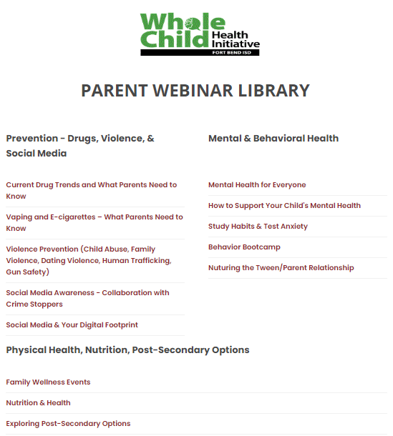
Whole Child Health Parent Webinar Library

Slide 25
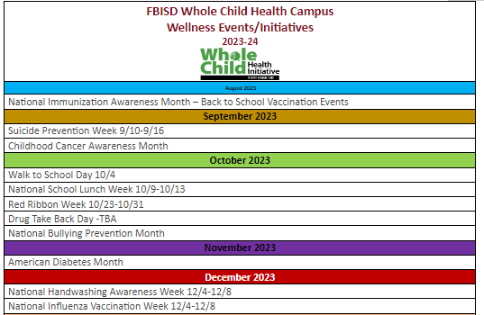
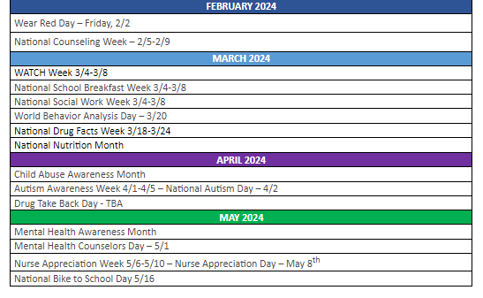
Whole Child Heath - Campus Events & Initiatives​

Slide 26
2023-24 Whole Child Health Webinar Series

Slide 27
The District Student Wellness COALITION
Notes:
The key strategies to accomplish our goals of increasing awareness and decreasing stigma include parent education, counselor support, student voice and promotion, continuing to expand services and to continue to develop business and community partnerships to both serve students and to help us promote our existing supports and resources. Obviously, to increase awareness and decrease stigma, education is the foundation. We are planning out 5 district level COALITION meetings for 4 students from each high school. These 45 students will represent their campus and lead their campus Student Wellness Committees (SWC). The COALITION Ambassadors will partner with campuses to do their own events for their community.

Slide 28
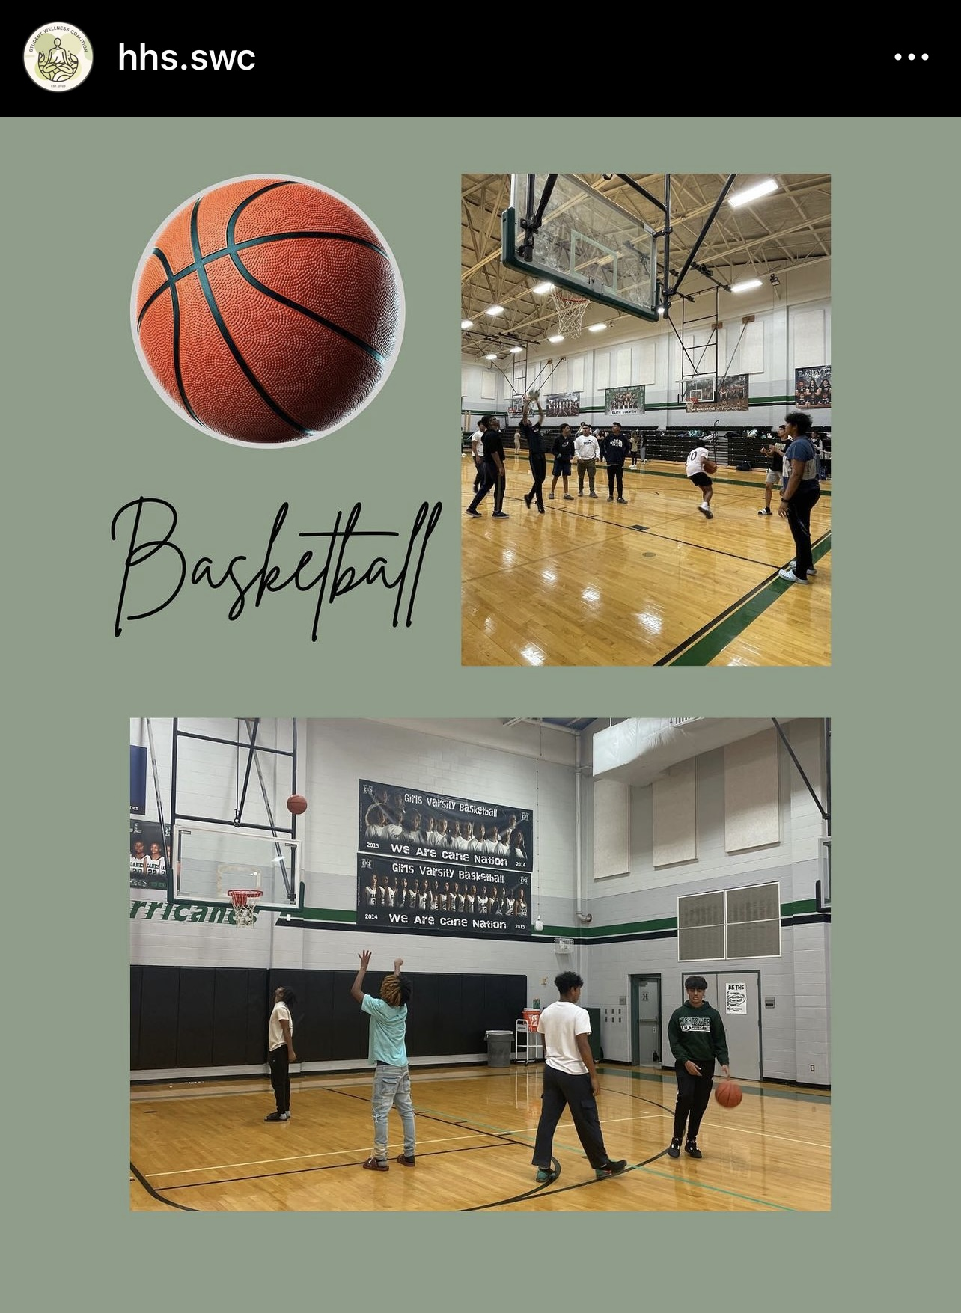
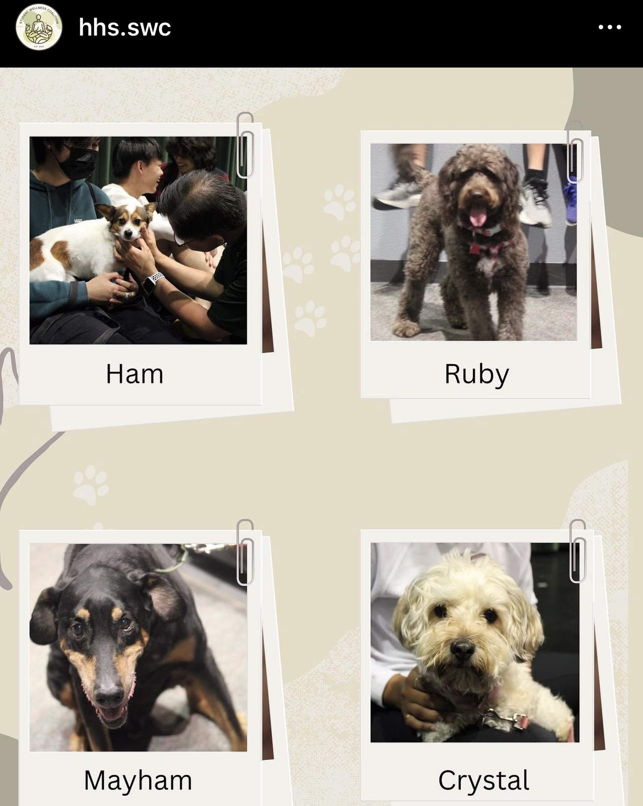
Student Wellness Committees​
Smoothie Bike provided by SHAC

Slide 29
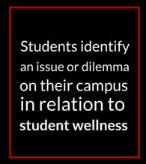
Whole Child Health Think Tank Event
Notes:
In collaboration with the FBISD School Health Advisory Council (SHAC) and United Health Care, Whole Child Health will host the Think Tank Competition for a second year. The Think Tank Competition is an outlet for students to have a voice for change on their campus and the over wellness of the student body. Campus Student Wellness Committees (SWC) work with their peers to identify an issue or dilemma that their campus is facing in relation to student mental, physical, or nutritional health. Once students identify an issue/dilemma on their campus, SWCs will come up with a solution to help combat their campus’ issue. The solution could be an event, a program, or a product that helps bring awareness to the issue. Students will present to a panel of stakeholders who will choose 1st, 2nd, and 3rd place winners of grant funds donated by the United Health Care and the Fort Bend Education Foundation.
Grand Fund Allocations:
1st place - $1,200
2nd place – $800
3rd place - $500
Video Link https://www.fortbendisd.com/Page/144432

Slide 30
Questions?

Slide 31
Vote
SHAC Meeting Minutes
May 17, 2023
Jenna Ross
SHAC Secretary

Slide 32
Brain Break
Angela Espinosa
FBISD Social Emotional Learning Coordinator

Slide 33
Upcoming Events
LaDonna Green
FBISD Wellness, Health & Prevention Specialist

Slide 34
September Whole Child Health Campus Events & Initiatives
Suicide Prevention Week
9/10-9/16
Childhood Cancer Awareness Month

Slide 35
Upcoming Whole Child Health Webinars
Mental Health is For Everyone
Parent Webinar
September 13, 2023
6-7 PM
Mental Health Support for Students
Student Webinar
October 18, 2023
6-7 PM
Link to Webinar Page

Slide 36
Liaison Action Items
Liaison To Do List
Join CWC or make contact with your campus rep
Research grants for your school (VHS or SHAC google drive)
Spread the word about SHAC, resources
4) Promote upcoming health initiatives:
September 2023
Suicide Prevention Week 9/10-9/16
Childhood Cancer Awareness Month
October 2023
Walk to School Day 10/4
National School Lunch Week 10/9-10/13

Slide 37
Subcommittees Convene
Subcommittees Convene
Whole Child Health, Nutrition, Advocacy, Health & Safety, Health & PE, Campus Wellness

Slide 38
Meeting Closure
October 18, 2023
12 p.m. – 2 p.m.
Fort Bend ISD Administration Building
Boardroom
16341 Lexington Blvd
Sugar Land TX 77479

Slide 39
FORT BEND ISD
16431 Lexington Blvd.
Sugar Land, TX 77479
281-634-1000
www.fortbendisd.com

